Slide 1
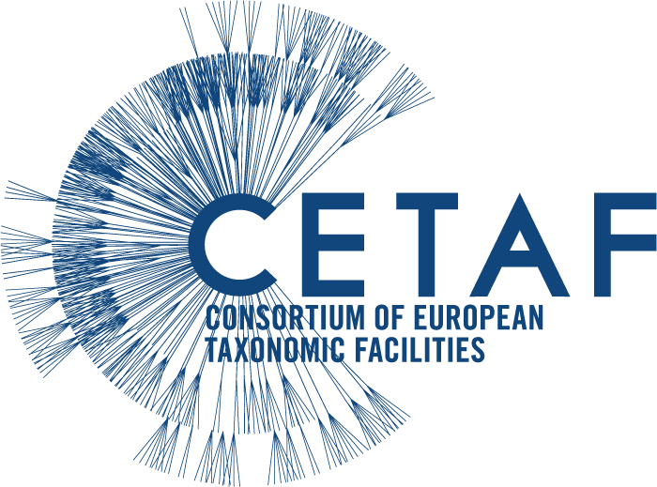
The Specifications of Earth Science Collections
By the CETAF Earth Science Group
Authors: Laura Tilley, Johanna Eder, Bjorn Berning, Charalampos Fassoulas, Stephan Kiel, Andreas Kroh, Jiri Kvacek, Giles Miller, Michael Rasser, Rachael Walcott
Notes:
This presentation aims to give a brief insight into the scope of Earth Science Collections, how they are curated, useful terminology and the minimum information that is required for discoverability in a online world catalogue. The information is from the Earth Science Group Science.

Slide 2
What is the CETAF Earth Science Group
A working group within CETAF that consists of EU institutes from: Austria, Belgium, Czechia, Estonia, Finland, Germany, Greece, Hungry, Netherlands, Spain, Sweden and UK.
Work Topics
Cultural Goods Legislations
Type specimen Survey
Collecting information on EU legislation for the import and exports of cultural goods within and outside the EU.
Collecting information on the number of type specimens in CETAF institutes and the percentage that is digitised
Promoting the Importance of Earth Science
Field collecting legislation
Collecting information on EU countries legislation and best practices for field collecting.
e.g. Publication: Hazards and Disasters in the geological and geomorphological record: a key to understanding past and future hazards and disaster.
Contributing to specimen and collection level standards
Development of Earth Science Portal (GeoCASe)

Slide 3
The scope and curation of Earth Science collections
Earth Science covers the main disciplines: Geology, Palaeontology and sometimes extraterrestrial.
Based on the development of Classification Schemes as part of the SYNTHESYS+ Collection Digitisation Dashboard:
High-level organisation of collections
Taxonomically (Object type)
Stratigraphy (Chronostratigraphy)
Following the International Commission on stratigraphy
http://stratigraphy.org/index.php/ics-chart-timescale
Storage type:
Relating to the form in which the objects are stored (e.g. dry, fluid preserved, hand specimens, thin sections).
Geographic origin
The region from which an object was collected.
Some collections may have additional categorisation – national vs foreign, continents, countries and localities.

Slide 4
Example Taxonomic types:
High-level collection classifications (below) have been developed in SYNTHESYS+ for the Collections Digitisation Dashboard (a tool for discoverability of collections and prioritization of digitization, decision making).
Main Category | Category
Palaeontology | Botany & Mycology Invertebrates Vertebrates Trace fossils (e.g. footprints, feeding traces, etc.) Microfossils Other
Geology | Mineralogy Petrology Loose sediment Other
Extraterrestrial | Collected on Earth (e.g. meteorites) Collected in space

Slide 5
Example of Storage types
Main Category | Subcategory
Palaeontology Geology Extraterrestrial | Palaeontology: Macrofossils (dry preserved) Palaeontology: Mesofossils (dry preserved) Palaeontology: Microfossils (dry preserved) Palaeontology: Macrofossils (fluid preserved) Palaeontology: Mesofossils (fluid preserved) Palaeontology: Microfossils (fluid preserved) Palaeontology: Fossils preserved in Amber, natural resin Palaeontology: Microscope slides Palaeontology: Oversized fossils Palaeontology: Other Geology: Macro-objects Geology: Micro-objects Geology: Cut/polished Gemstones Geology: Microscope slides Geology: Cores Geology: Fluids Geology: Oversized objects Geology: Hazardous material/objects Extraterrestrial: Macro-objects Extraterrestrial: Micro-objects Extraterrestrial: Oversized objects Extraterrestrial: Microscope slides Extraterrestrial: Other
From the SYNTHESYS+ Collection Digitisation Dashboard

Slide 6
Required minimum metadata for the discoverability of collections
Taxon type/Object type (concerning fossils (?), rocks and mineral)
Repository number
Stratigraphy (Chronostratigraphy)
Geographic origin (Continent, Region, County)
Housing institution
Curator / contact address
Desirable information at a higher granularity:
Lithostratigraphy could be useful – but is not required. Generally this information is to granular for collection curation but maybe useful for comparison with Chronostratigraphy. Lithostratigraphy terminology is challenging to standardize.
Specific Locality

Slide 7
Further Examples of curation from CETAF members
Petrology
To a more granular level rocks can be catagorised as Igneous, Sedimentary and Metamorphic.
Additionally can be organized by rock chemistry (as for National Museum of Scotland)
Meteorites are organised alphabetically by fall or find name (following The Meteoritical Society) (as for the National Museum of Scotland).
Minerology (National Museum of Scotland)
At a more granular level – minerals are arranged by the ‘Dana 8 method’ a mixture of mineral and chemistry structure.
http://webmineral.com/danaclass.shtml#.XodTYUxuLSE

Slide 8
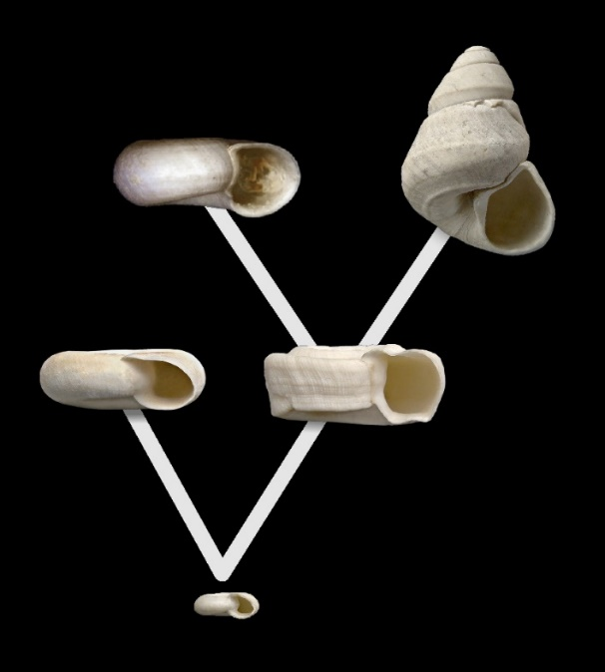
Importance of Earth Science Collections
Fragmentary record (Morphospecies concept)
A few examples:
Bridging the gap between Palaeontology and Biology
Reliance on the physical aspects of fossils has led to realisation of relationships between organism physiology and environmental - often overlooked in biology.
Evolutionary History
They provide a deep time perspective of species and environmental controls of speciation and extinction.
Courtesy of Johanna Eder (State museum of Natural History – SMNS)
Help understand future global change
Evidence for the impacts of past climate change on biodiversity.
The processes, causation and impacts of Geohazards/Natural Induced Disasters.
Courtesy of Michael Rasser SMNS)

Slide 9
Summary
At a high-level - Earth Science collection classifications are similar to those of modern biology collections (e.g. Taxonomical type, Geographic origin, Storage type, BUT they have an extra dimension – Chronostratigraphy.
Chronostratigraphy is considered adequate information and Lithostratigraphy can be useful but overall too granular for collection categorization, plus there are complications around terminology.
Earth Science collections strongly contribute to our current understanding of biodiversity loss and environmental change.
Paleontology and biology can benefit each other thus it is important that Earth Science data is standardized and made accessible through biodiversity informatics and international catalogues/platforms.

